Slide 1
Neural Networks
Tim Smith, PhD

Slide 2
Introduction
Can we build an algorithm that "learns" like humans?
Can we mimic human brain?

Slide 3
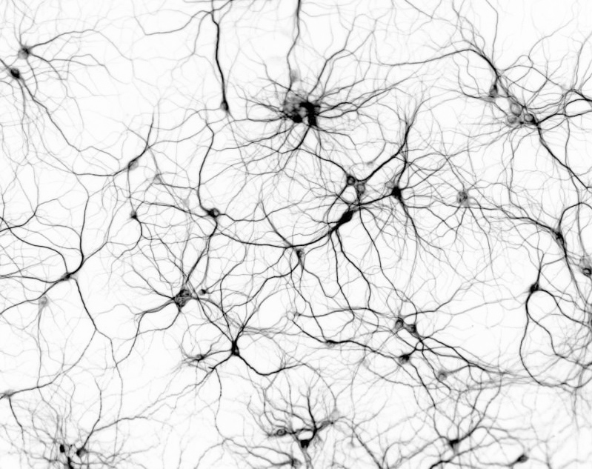
Biological Neurons
Source: http://www.thenanoage.com/forums.htm

Slide 4
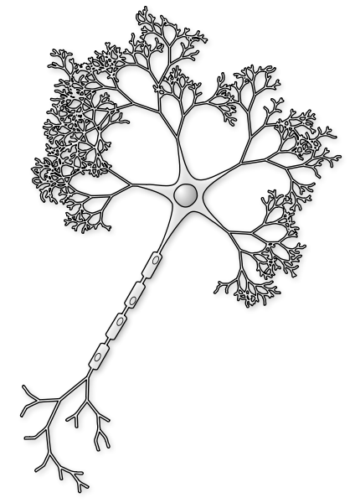
Biological Neurons
3
When cell excitement exceeds a threshold it "fires"
1
Inputs from other neurons
4
Electrical signal
Inputs can increase/decrease cell "excitement"
2
Picture source: http://commons.wikimedia.org/wiki/File:Neuron-figure-notext.svg

Slide 5


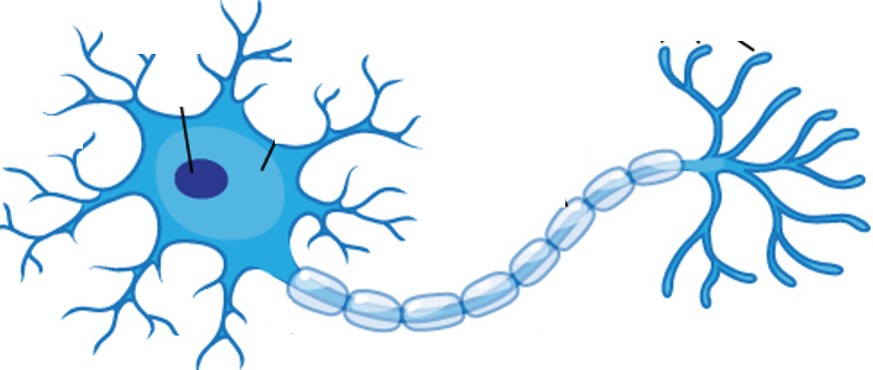
A network of neurons processes stimulus and calculates a response…
Likes this song

Slide 6

Different pathways can calculate different responses…
Doesn’t like this song

Slide 7
Our brains are a much more complex network of neurons…
Your brain is a massively parallel interconnected network of 10¹¹ neurons (100 billion), with over 100 trillion connections!
NOTE: ChapGPT-3 has 175 billion parameters (connections).
Using 1,024 V100 GPU’s, it took 34 days to train. To train 100 trillion with this same hardware, it would take 53 years.

Slide 8
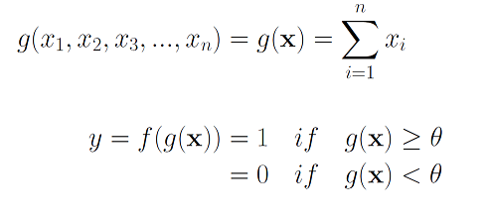

Perceptron History
McCulloch-Pitts Neuron – First mathematical model of biological neuron (1943)
Disadvantages of McCulloch-Pitts neuron was its simplicity. It only allowed for binary inputs and outputs, it only used the threshold step activation function and it did not incorporate weighting the different inputs.
x₁
x₂
g
f
y
x₃
x_{n}

Slide 9
Hebb’s Rule (1949)
“When an axon of cell A is near enough to excite a cell B and repeatedly or persistently takes part in firing it, some growth process or metabolic change takes place in one or both cells such that A’s efficiency, as one of the cells firing B, is increased.”
Hebb was proposing not only that, when two neurons fire together the connection between the neurons is strengthened, but also that this activity is one of the fundamental operations necessary for learning and memory.
[1] Hebb, Donald O. (1949). The Organization of Behavior. New York: Wiley, pg. 62.

Slide 10
Resenblatt’s “Perceptron” (1958)
Incorporating ideas from Hebb’s rule, Frank Rosenblatt improved upon McCulloch-Pitts Neuron and created what he called a “Perceptron”
Rosenblatt updated the McColloch-Pitts neuron to include weights and biases.
Also, instead of a threshold step function, other functions were explored – these served the role of “activation” functions (i.e. Sigmoid)

Slide 11
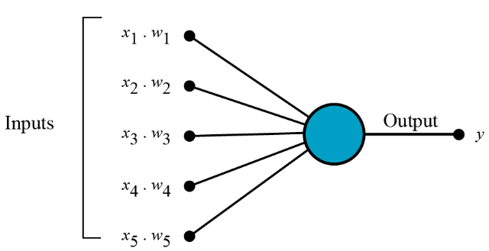
How does perceptron work?
1. All the inputs (signals) x are multiplied with their weights w.

Slide 12
Neural Network
Example: predicting loan default
Input variables
Output
Age | Credit score | Kids | Default
30 | 750 | 2 | 0
45 | 800 | 1 | 1
… | … | … | …
… | … | … | …
… | … | … | …
Age | Credit score | Kids | Default
1.08 | 1.69 | 0.75 | 0
1.84 | 1.72 | 0.41 | 1
… | … | … | …
… | … | … | …
… | … | … | …
Standardize

Slide 13
Neural Network
Input layer
Output layer

Slide 14
Neural Network
'inside’ each neuron is an activation function.
NOTE: Activation functions introduce non-linearity. Without them, this would simply be a multi-path linear regression model.
Create "hidden" neurons:
Input layer
Output layer
Hidden layer

Slide 15
Neural Network
Establish “connections”:
Input layer
Output layer
Hidden layer

Slide 16
Neural Network
Bias in a neural network is required to shift the activation function across the plane toward the left or the right.
Add “bias” to each neuron:
Bias θ₁
Alternate diagram on the next page – they are the SAME!
Bias θ₂
Bias θ₃
Input layer
Output layer
Hidden layer

Slide 17
Neural Network
Bias
1
Add “bias” to each neuron:
Sometimes you will see biases represented as inputs to the neuron.
Bias
1
Input layer
Output layer
Hidden layer

Slide 18
Neural Network
Weights are values associated with the features (our output from layer n-1). They transform the activation function (flip, stretch, etc.). They indicate the importance of each feature.
Initialize all connections with random weights:
0.01
0.013
0.024
Input layer
Output layer
Hidden layer

Slide 19
Neural Network
Initialize the bias values:
0.01
0.013
0.1
0.2
0.3
0.024
Input layer
Output layer
Hidden layer

Slide 20
Neural Network
TRAINING:
Send the first observation,
At each node:
Multiply the input values with initialized weights,
Sum the results and the bias term
Send the result to an activation function (that decides whether to fire off or not)
Compare the output value to the actual value (at the output layer)
Tweak the weights (using the backpropagation algorithm)
The backpropagation algorithm works by computing the gradient of the loss function with respect to each weight by the chain rule, computing the gradient one layer at a time, iterating backward from the last layer.
Increases the weights that lead to correct classification
Weaken the weights that lead to incorrect classification
Repeat for the next observation

Slide 21
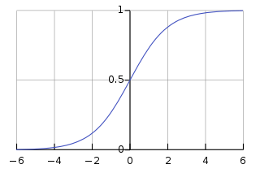
Neural Network
Activation function
Send the first observation
0.01
Age = 1.08
0.013
0.1
Credit = 1.69
Default = 1
0.2
Kids = 0.75
0.3
0.024
Input layer
Output layer
Hidden layer

Slide 22
Neural Networks
Actual training:
For the first "epoch":
Divide the data set into "batches" (mini-samples)
Send the first "batch" through the neural network
Compare their true values with predicted values
Calculate the error
Tweak the weights and biases (using the backpropagation algorithm)
Send the next batch, and repeat…
Repeat for the next epoch (until you reach epochs=n, or meet a minimum threshold for improvement)
Test:
Test the model on unseen data

Slide 23
Neural Network
0.017
Let's say, model accuracy on unseen data = 95%
Age
0.033
0.15
Credit
Default
0.22
Kids
0.4
0.027
Input layer
Output layer
Hidden layer

Slide 24
Neural Network
Send new observation
Neural Network Model
(a black box)
0.017
Age = 0.52
Prediction
0.033
0.15
Credit = 0.66
Default = 1
0.22
Kids = 0.02
0.4
0.027

Slide 25
Deep Neural Network
Layer 1
Layer 2
Layer 3
This is a
feedforward network
Input layer
Output layer
Hidden layers

Slide 26
Neural Network Architectures – Binary output
1
1
1
1
1
2
2
2
1
…
…
…
…
3
3
3
p
…
…
m
…
k
n
n
n
Perceptron
(no hidden layer)
Same as log.reg.
Scikit: SGDClassifier
Multi-layer Perceptron
(one hidden layer)
Scikit: MLPClassifier
Tensorflow: Keras
Multi-layer Perceptron
(more hidden layers)
Scikit: MLPClassifier
Tensorflow: Keras

Slide 27
Neural Network Architectures – Multiclass
E.g.: 3 classes
1
1
1
Softmax
1
Softmax
1
2
Softmax
2
2
1
…
…
…
…
3
3
3
p
…
…
m
…
k
n
n
n
Perceptron
(no hidden layer)
Multi-layer Perceptron
(one hidden layer)
Scikit: MLPClassifier
Tensorflow: Keras
Multi-layer Perceptron
(more hidden layers)
Scikit: MLPClassifier
Tensorflow: Keras
https://developers.google.com/machine-learning/crash-course/multi-class-neural-networks/softmax

Slide 28
Backpropagation
It involves the chain rule and gradient descent
Initialize W_{ij} and Bias
Send batch 1
Calculate the error
Go through each layer in reverse order,
Measure how much each neuron contributes to error
Gradient descent step
Repeat n times (i.e., n epochs)
Adjust W_{ij} and Bias
Send batch 2
Calculate the error
Repeat

Slide 29
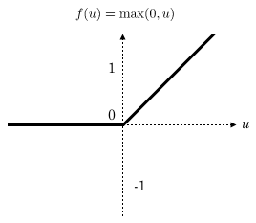
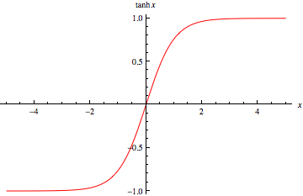
Activation functions
tanh
ReLU (rectifier linear unit)
Not differentiable at 0. Makes gradient descent bounce around. But still works well.

Slide 30
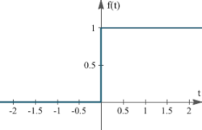
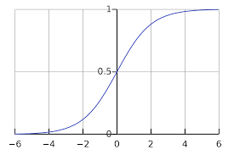
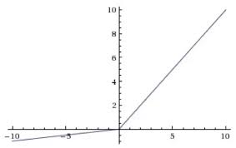
Other Activation Functions
Step/heavyside
Sigmoid
Leaky ReLU

Slide 31
Neural Network
Can be built using different libraries:
Scikit: MLPClassifier (or MLPRegressor)
Tensorflow: Keras Dense Layer
NOTE: Next week, we will begin using Keras/Tensorflow

Slide 32
Training using Scikit
High level API
Can build deep networks
Hyperparameter: hidden_layer_sizes = (100, )
Some other hyperparamaters:
activation
solver
alpha (L2 penalty)
learning rate
max_iter
etc.

Slide 33
Fine Tuning Hyperparameters
How do you find a good set of hyperparameters
Trial-error
Grid search (with cross-validation)
Randomized grid search

Slide 34
Number of Layers
Start with 1 hidden layers
More than adequate in most cases
Can achieve high accuracy
More layers might result in overfitting!
If working with images: (Convolutional Neural Networks)
Might need hundreds of layers

Slide 35
Number of Neurons
Input and output layers are pre-determined!
Hidden layers are customizable
Funnel shape
Pipe shape
More neurons might cause overfitting!
Prevent overfitting:
Select a large number of hidden layers and neurons, then, use "early stopping"
Use L2 regularization (the "alpha" parameter)

Slide 36
Advantages and Disadvantages
Advantages:
Good performance
Can handle noisy data
Can capture complex relationships (isn't restricted to linear)
We don't "tell" the nature of relationships!
Disadvantages:
Black-box
Needs lots of data
No variable selection
Resource intensive

Slide 37
More on the perceptron…
In the summer session, the section is optional.
If you wish to understand more about what a neural is doing and how it’s doing it, this section will elaborate on some of these fundamentals.
In the summer session, you will not be expected to know this – and will, therefore, not be tested on anything specific to this section.

Slide 38
Perceptron History
McCulloch-Pitts Neuron – First mathematical model of biological neuron (1943)
Disadvantages of McCulloch-Pitts neuron was its simplicity. It only allowed for binary inputs and outputs, it only used the threshold step activation function and it did not incorporate weighting the different inputs.
x₁
x₂
g
f
y
x₃
x_{n}

Slide 39
Hebb’s Rule (1949)
“When an axon of cell A is near enough to excite a cell B and repeatedly or persistently takes part in firing it, some growth process or metabolic change takes place in one or both cells such that A’s efficiency, as one of the cells firing B, is increased.”
Hebb was proposing not only that, when two neurons fire together the connection between the neurons is strengthened, but also that this activity is one of the fundamental operations necessary for learning and memory.
[1] Hebb, Donald O. (1949). The Organization of Behavior. New York: Wiley, pg. 62.

Slide 40
Resenblatt’s “Perceptron” (1958)
Incorporating ideas from Hebb’s rule, Frank Rosenblatt improved upon McCulloch-Pitts Neuron and created what he called a “Perceptron”
Rosenblatt updated the McColloch-Pitts neuron to include weights and biases.
Also, instead of a threshold step function, other functions were explored – these served the role of “activation” functions (i.e. Sigmoid)

Slide 41
How does perceptron work?
1. All the inputs (signals) x are multiplied with their weights w.

Slide 42
How does perceptron work?
2. All input (signals) are summed up
Add all the multiplied values and call them Weighted Sum.

Slide 43
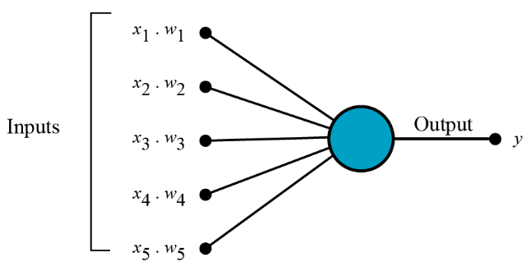
How does perceptron work?
3. Adding in a Bias value
b
Perceptron also adjusts the bias during the learning phase.

Slide 44
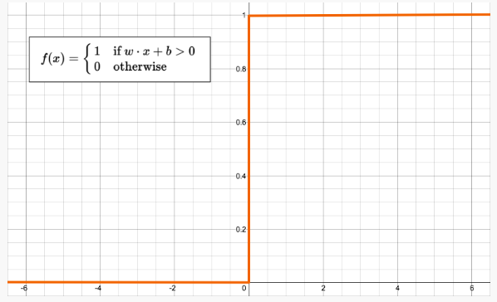
How does perceptron work?
Class 1
1
4. Activation
-1 otherwise
Class 2
-1

Slide 45
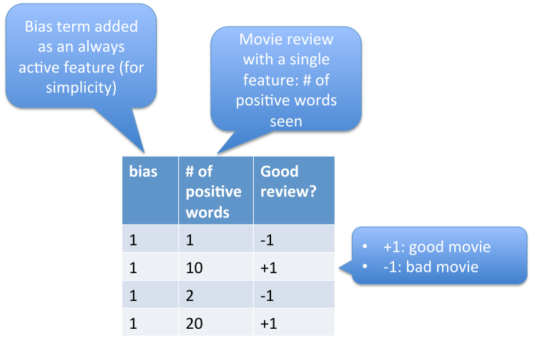
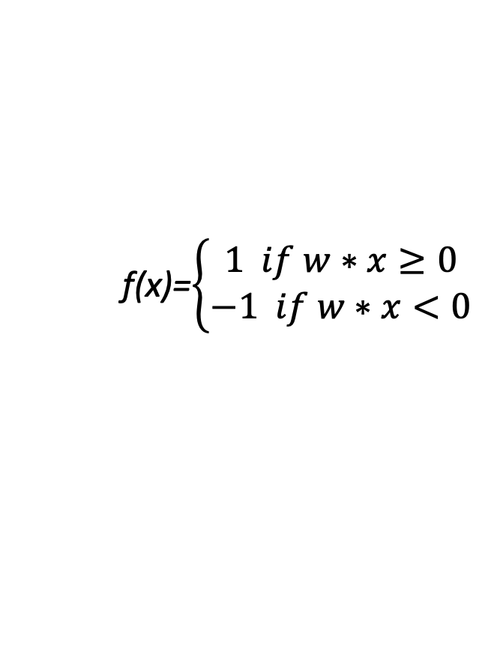
Example: good movie or bad movie?
f(x)=$\left\{\begin{aligned}1 if w∗x≥0 \\ −1 if w∗x<0\end{aligned}\right.$

Slide 46
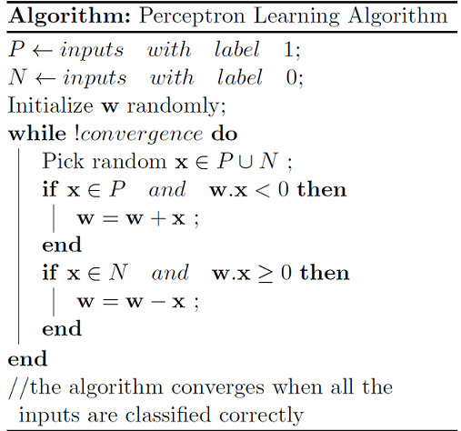
Example: good movie or bad movie?
1
-1
N
P
N
P

Slide 47
Example: good movie or bad movie?
1
-1
N
P
N
P
w = 0

Slide 48
Example: good movie or bad movie?
1
-1
N
P
N
P
w = 0

Slide 49
Example: good movie or bad movie?
1
-1
N
P
N
P
w = 0
x = 1
w*x=0 ≥ 0 →
means the classification is wrong
w = w-x = 0-1=-1

Slide 50
Example: good movie or bad movie?
1
-1
N
P
N
P
w = -1
x = 10
w*x= -10 < 0 →
means the classification is wrong
w = w+x = -1+10=9

Slide 51
Example: good movie or bad movie?
1
-1
N
P
N
P
w = 9
x = 2
w*x= 18 ≥ 0 →
means the classification is wrong
w = w-x = 9-2=7

Slide 52
Example: good movie or bad movie?
1
-1
N
P
N
P
w = 7
x = 20
w*x= 140 ≥ 0 →
means the classification is correct

Slide 53
Example: good movie or bad movie?
1
-1
N
P
N
P
w = 7
x = 1
w*x= 7 ≥ 0 →
means the classification is wrong
w=w-x=7-1=6

Slide 54
Example: good movie or bad movie?
1
-1
N
P
N
P
w = 6
x = 10
w*x= 60 ≥ 0 →
means the classification is correct

Slide 55
Example: good movie or bad movie?
1
-1
N
P
N
P
w = 6
x = 2
w*x= 12 ≥ 0 →
means the classification is wrong
w=w-x=6-2=4

Slide 56
Example: good movie or bad movie?
1
-1
N
P
N
P
w = 4
x = 20
w*x= 80 ≥ 0 →
means the classification is correct

Slide 57
Example: good movie or bad movie?
1
-1
N
P
N
P
w = 4
x = 1
w*x= 4 ≥ 0 →
means the classification is wrong
w=w-x=4-1=3

Slide 58
Example: good movie or bad movie?
1
-1
N
P
N
P
Continue ……
Till

Slide 59
Worked example
See notebook nn-perceptron.ipynb for an illustrative example of this algorithm.

